Slide 1


3D Bounding Box Estimation
Projektpraktikum Maschinelles Lernen
SS 2017
15.09.2017
S. Aklanoglu, T. Fuhrmann

Slide 2
Motivation
2D – Bounding Box
3D – Bounding Box
Demo
Evaluation
Future Work
3rd STAGE
Backgroundsubstraction
Convex Hull
Vanishing Points
Tangents
1st STAGE
Goal
Background
2nd STAGE
CNN
Tensorbox
4th STAGE
Results
Challenges
Solutions
5th STAGE
Improvements

Slide 3
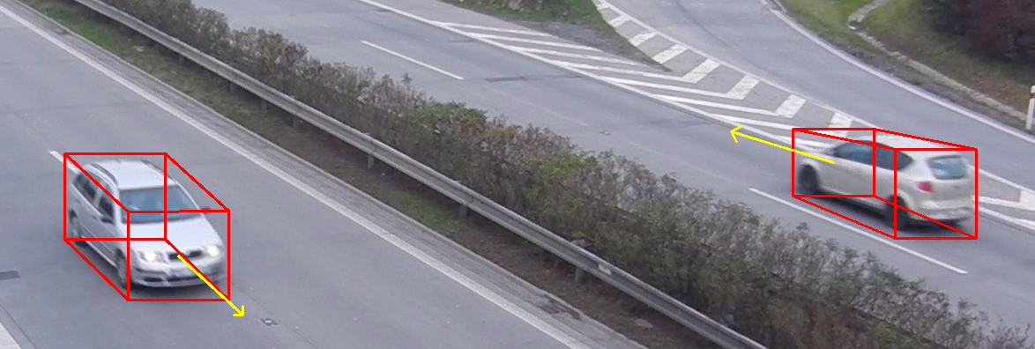
1. Motivation
Goal: 3D bounding box and moving direction annotations for traffic surveillance
Similar: M. Dubsk´a, J. Sochor, and A. Herout, “Automatic camera calibration for traffic understanding,” in Proceedings of BMVC 2014, 2014, pp. 1–10.
Additional Conditions:
Easiest approach
At least 10 FPS
15.09.2017
S. Aklanoglu, T. Fuhrmann

Slide 4
1. Motivation
Pipeline:
RGB image as input | 2D bounding boxes calculation with CNN | Background subtraction | Silhouette extraction | Tangent calculation with vanishing points | 3D bounding box calculation with intersection of tangents | Direction calculation and box refinements
15.09.2017
S. Aklanoglu, T. Fuhrmann

Slide 5
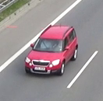
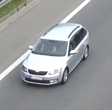
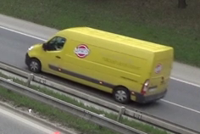
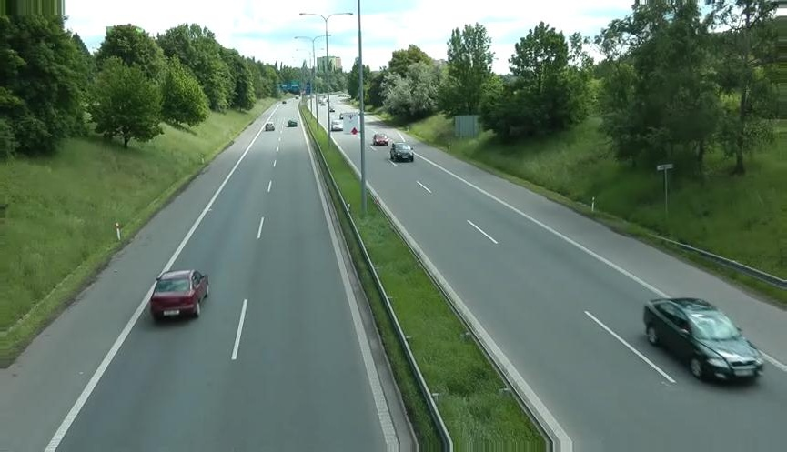
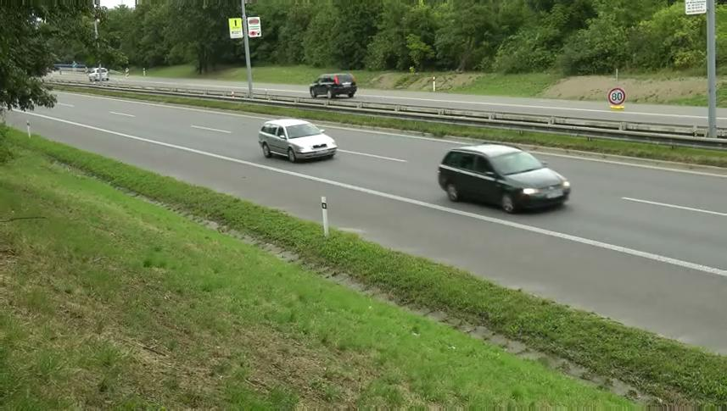
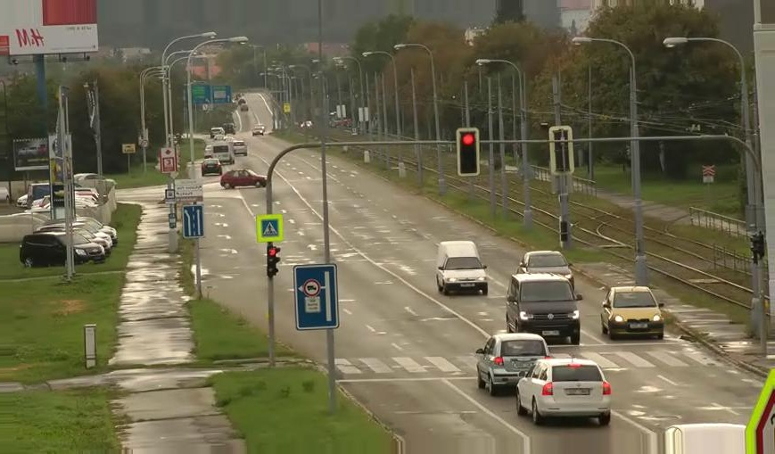
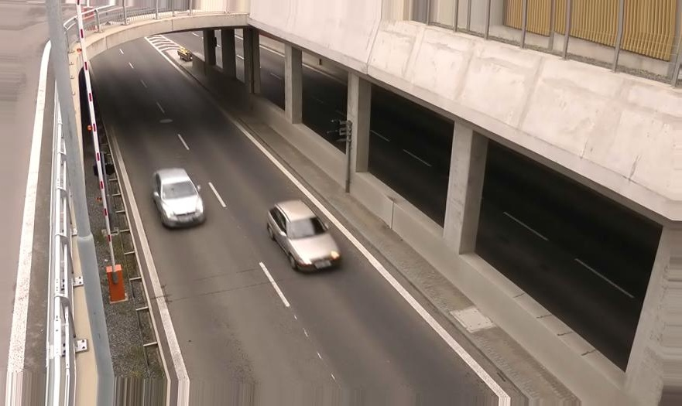
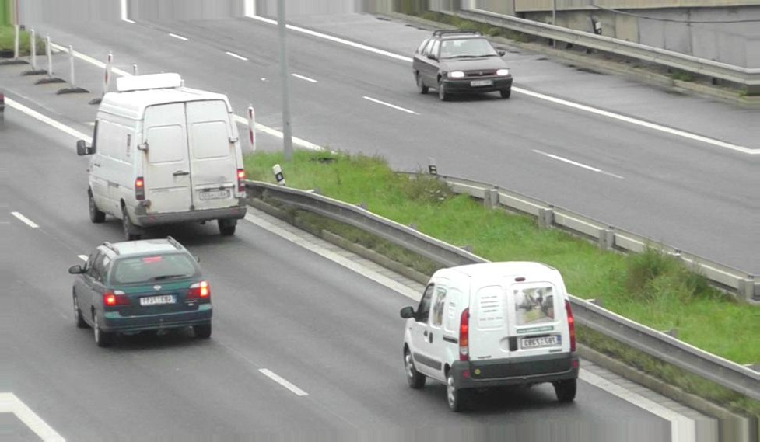
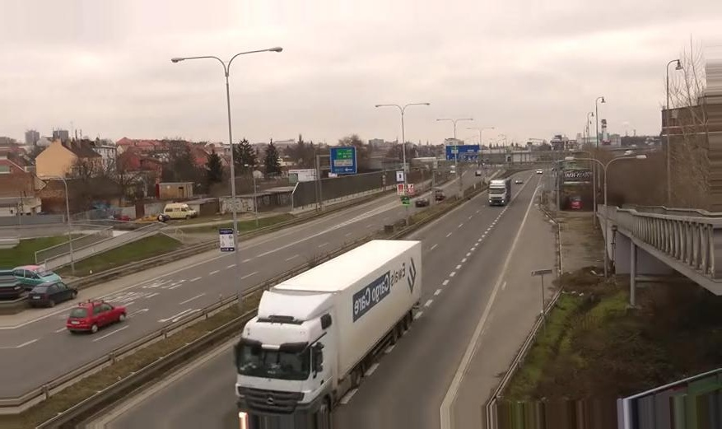
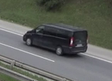
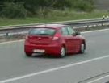
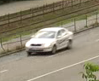
2. 2D – Bounding Box
Idea: Detect 2D bounding boxes and calculate convex hull within bounding boxes
Problem: Dataset with high quality annotations is needed
Solution: Training different CNNs with different datasets in TensorBox
BoxCars116K
COD20K
J. Sochor, J. pahel, and A. Herout, “Boxcars: Improving vehicle fine-grained recognition using 3d bounding boxes in traffic surveillance,” 2017.
J. Roman, H. Adam, D. Markta, and Z. Pavel, “Real-time pose estimation piggybacked on object detection,” in ICCV, 2015.
15.09.2017
S. Aklanoglu, T. Fuhrmann
3

Slide 6
2. 2D – Bounding Box
 | BoxCars116K |  | COD20K
 | Inception V1 | ResNet 101 | Inception V1 | ResNet 101
W x H | 224x224 | 224x224 | 864x480 | 864x480
Time (ms) | 56 | 107 | 56 | 115
Probleme aus https://github.com/TiFu/3D-Box-Presentations/issues/22 kurz aufzaehlen
15.09.2017
S. Aklanoglu, T. Fuhrmann
3

Slide 7
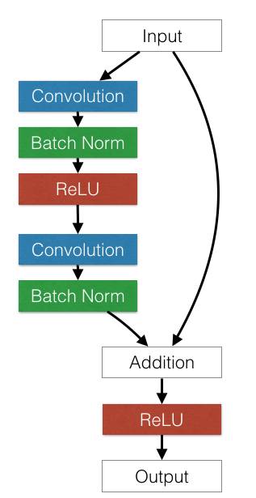
2. 2D – Bounding Box
Residual block architecture
ResNet:
adding extra layers results in higher training error and higher validation error caused by vanishing gradients
shortcut connections are summed with the output of the convolution layers
→ Avoids vanishing gradients
And:
Already integrated in TensorBox
Fast enough for the beginning with ~100ms on nvidia GTX 960M 2GB
K. He, X. Zhang, S. Ren, and J. Sun, “Deep residual learning for image recognition,” CoRR, vol. abs/1512.03385, 2015. [Online]. Available: http://arxiv.org/abs/1512.03385
15.09.2017
S. Aklanoglu, T. Fuhrmann
4

Slide 8
2. 2D – Bounding Box
TENSORBOX BESCHREIBEN
https://arxiv.org/pdf/1512.03385.pdf RESNET100
http://www.image-net.org/challenges/LSVRC/2013/slides/overfeat_ilsvrc2013.pdf
http://mdlai.com/2016/03/29/player-tracker/
R. Stewart and M. Andriluka, “End-to-end people detection in crowded scenes,” CoRR, vol. abs/1506.04878, 2015. [Online].
Available: http://arxiv.org/abs/1506.04878
15.09.2017
S. Aklanoglu, T. Fuhrmann
4

Slide 9
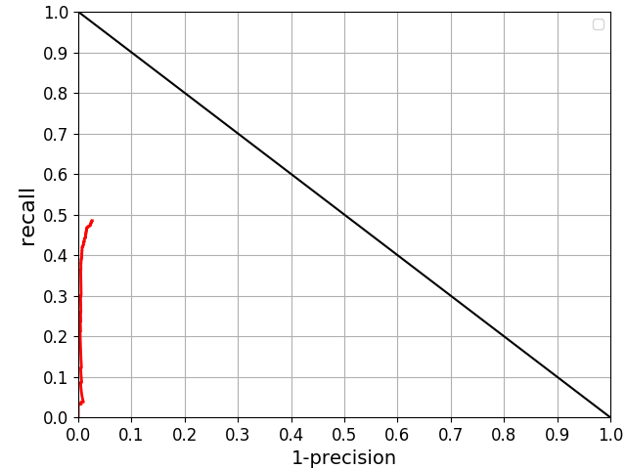
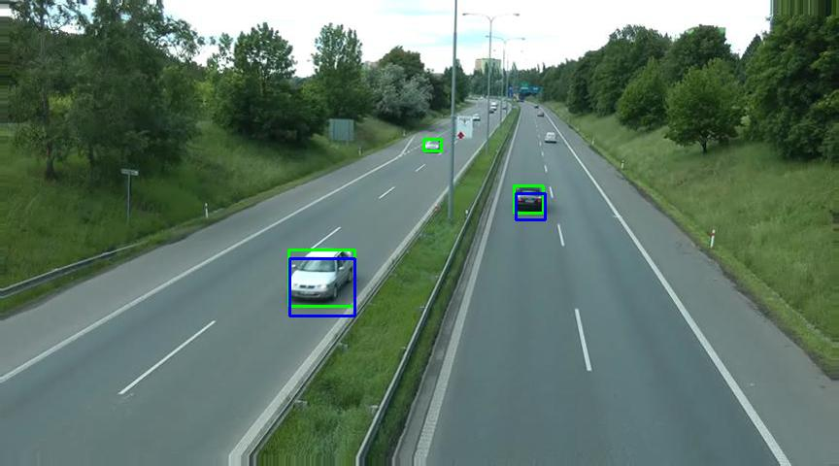
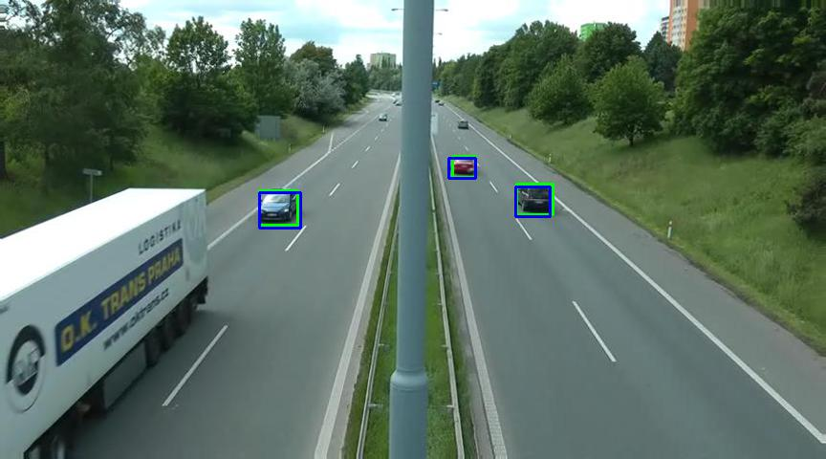
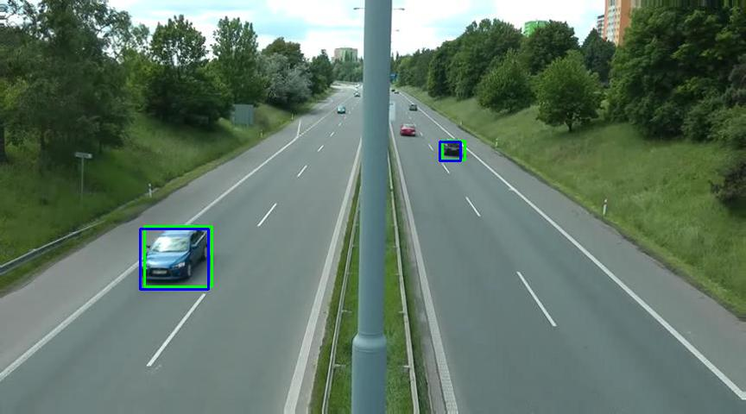
2. 2D – Bounding Box
Test with ResNet on COD20K
15.09.2017
S. Aklanoglu, T. Fuhrmann
5

Slide 10

2. 2D – Bounding Box
Test with ResNet on COD20K
Test with ResNet on COD20K with 10% smallest cars omitted
15.09.2017
S. Aklanoglu, T. Fuhrmann
5

Slide 11
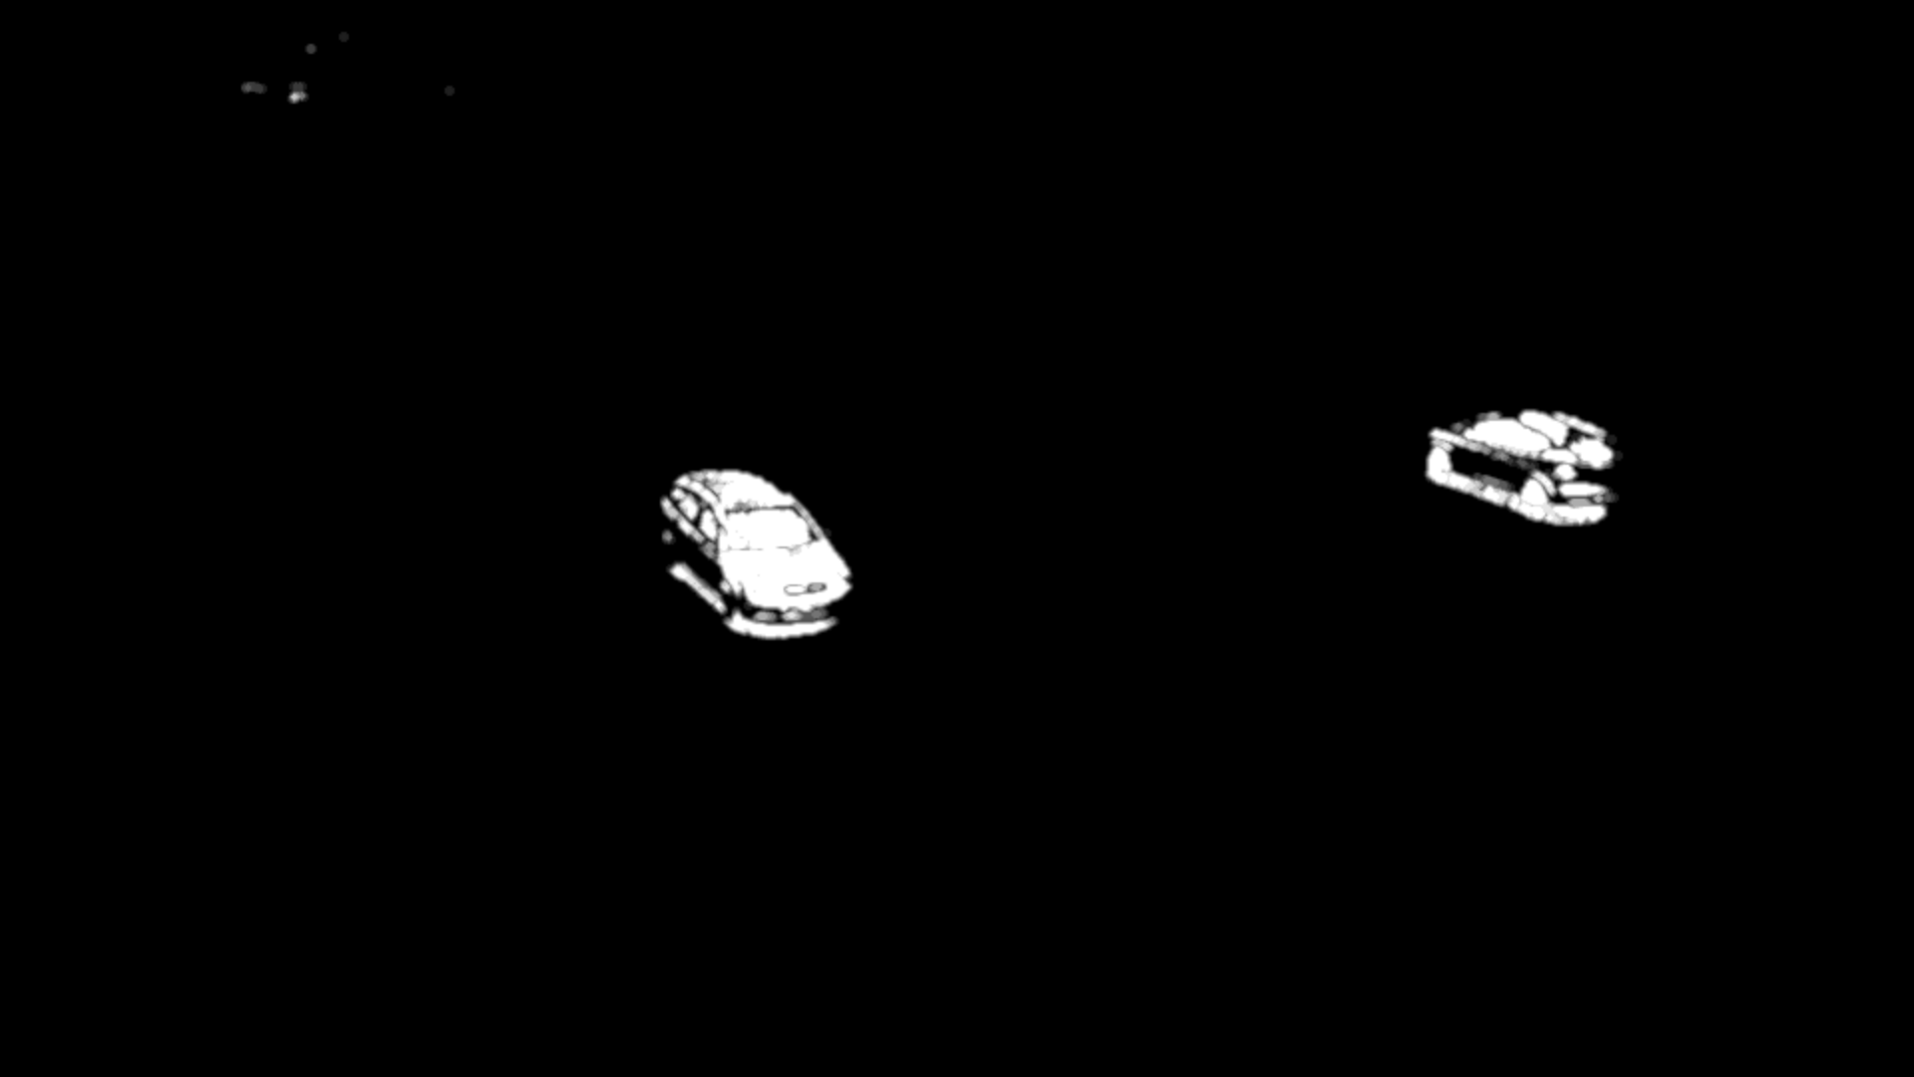
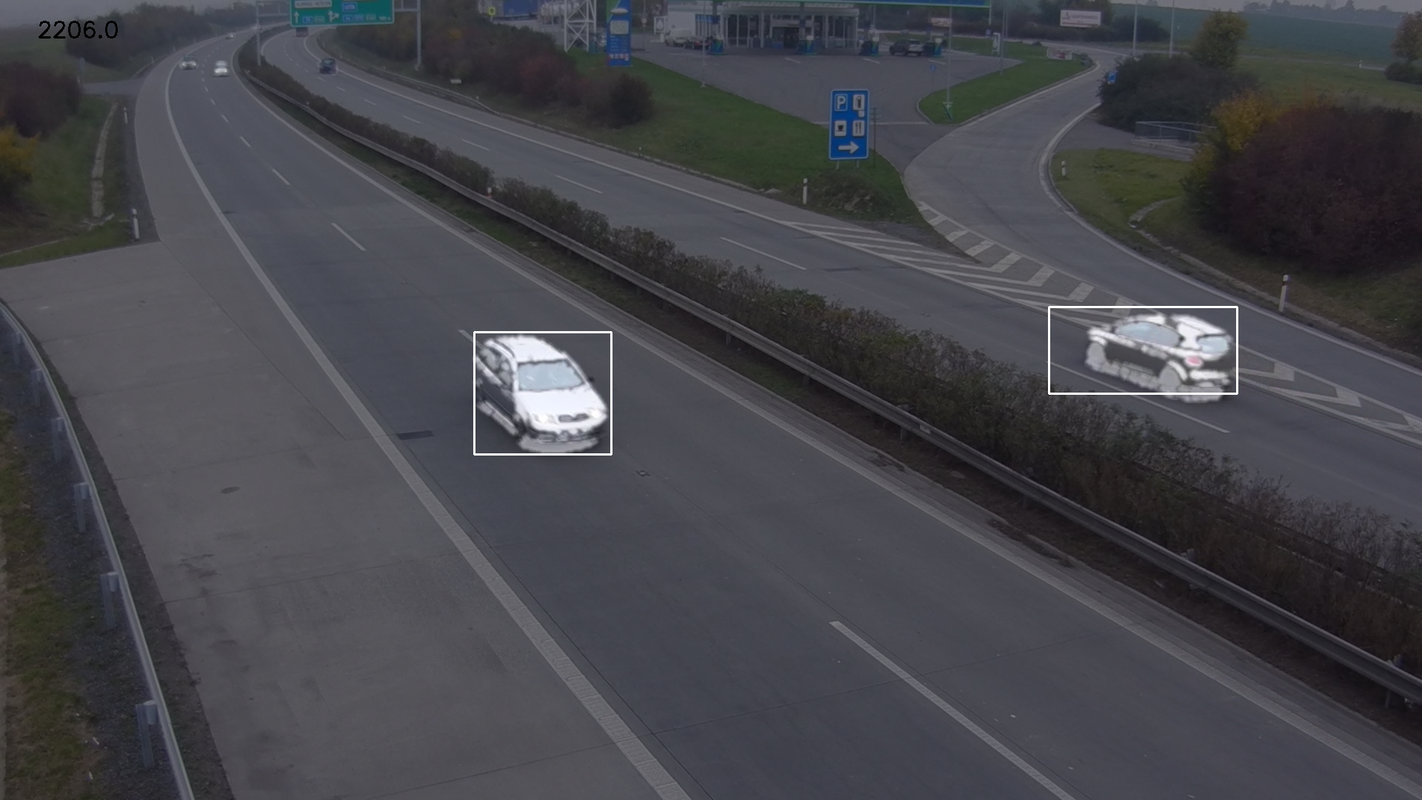
3. 3D – Bounding Box
Divided in 2 steps:
Background subtraction with opencv3 (KNN approach) with shadow filtering; first 10 - 20 frames of video are used for training the background subtraction ~ 13 ms
15.09.2017
S. Aklanoglu, T. Fuhrmann
6

Slide 12
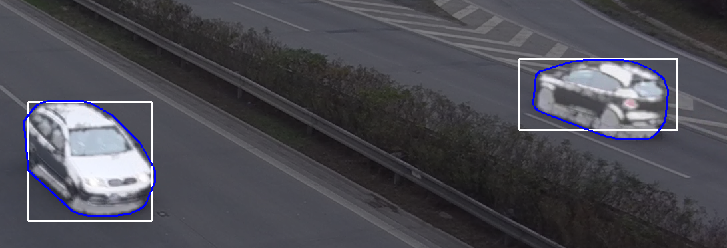
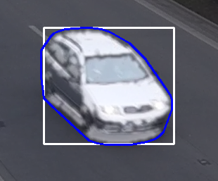
3. 3D – Bounding Box
Divided in 2 steps:
Convex hull calculation with opencv3
7

Slide 13
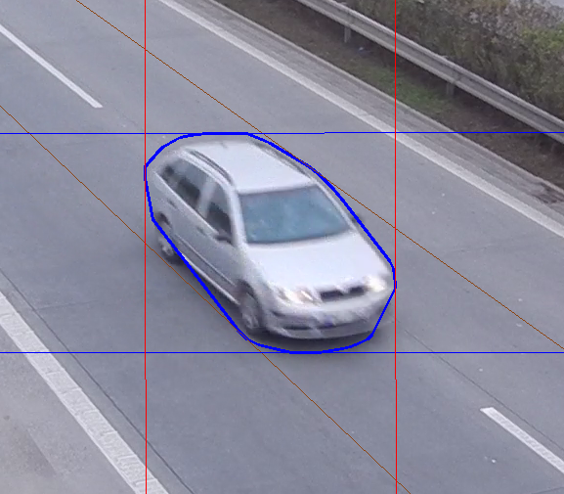
3. 3D – Bounding Box
VP1
VP2
(inf)
VP3 (inf)
15.09.2017
S. Aklanoglu, T. Fuhrmann
8

Slide 14
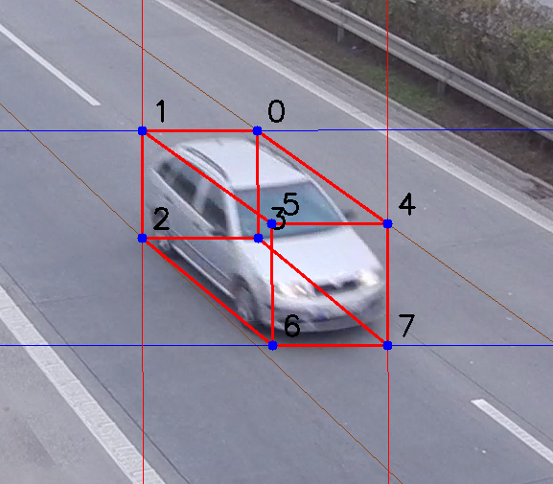
3. 3D – Bounding Box
15.09.2017
S. Aklanoglu, T. Fuhrmann
9

Slide 15
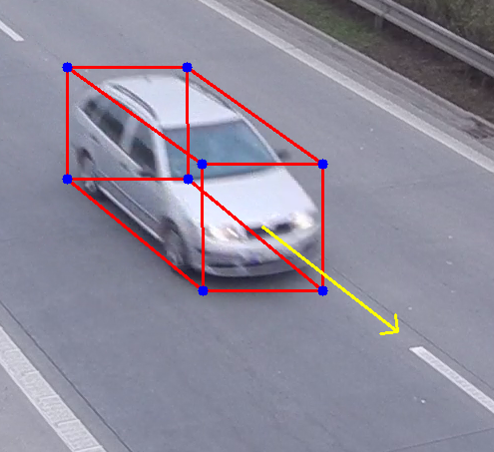
3. 3D – Bounding Box
15.09.2017
S. Aklanoglu, T. Fuhrmann
9

Slide 16
Demo

Slide 17
4. Evaluation
Overall average times on nvidia GTX 960M 2GB :
Operation | Time in ms
CNN | 115,50
Background Subtraction | 12,88
Hull Calculation | 0,31
3D Bounding Box Calculation | 0,93
Direction Calculation | 0,01
Drawing Boxes | 0,13
Total | 130,41
7,66 FPS

Slide 18
4. Evaluation
Small cars are not detected
Reason: COD20K annotations include small cars very rarely, net learns to ignore these, but sometimes they are annotated
Fix: better annotations: annotate all small cars, more data
reason for small recall, see image with big boxes ignored
Trucks are partially detected
Reason: not many trucks, but net detects parts (e.g. front) as car
Fix: training data with more trucks
Overlapping cars are not separated
Reason:Netz erkennt es u U nihct, Background Subtraction bei überlappenden Fahrzeugen ist ein großer Block
Fix:
Bushes detected as large cars
Reason: Bushes have many corners and colors => might look like car to the network
Fix: Background Subtraction gives small hull for brushes => exclude small hulls and do not draw 3d box
Precision Recall Curve
Bad annotations (offset, very small carse sometimes annotated)
Lösung: Offset zur Korrektur der Annotationen, Bild abschneiden, damit keine nicht markierten Autos im Datensatz enhtalten
leichte Verbesserung, von Recall wenn kleinste 10% der Boxen ignoriert
Bad Annotation Quality
Offset compared to video, in general missing annotations, randomly dropped annotations
Solution: improve annotations
15.09.2017
S. Aklanoglu, T. Fuhrmann
9

Slide 19
5. Future Work
Possible Improvements:
Combine both datasets and train one CNN
Driving direction could be derived by tracking cars over multiple frames
Estimate vanishing points from image
Estimate 3D bounding box with driving direction out of CNN
Data with 3D bounding box annotation needed
15.09.2017
S. Aklanoglu, T. Fuhrmann
9

Slide 20
Lessons Learned
Bad annotation quality of many datasets
Disk space issues with work station costs a lot of time and motivation
Good distribution of workload was essential
Gained deep insights in CNN architectures
→ Fast nvidia graphic card is required
15.09.2017
S. Aklanoglu, T. Fuhrmann
9

Slide 21
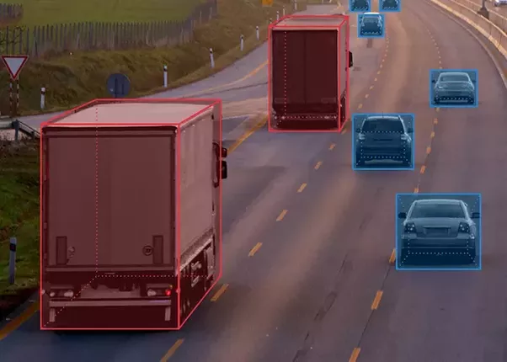
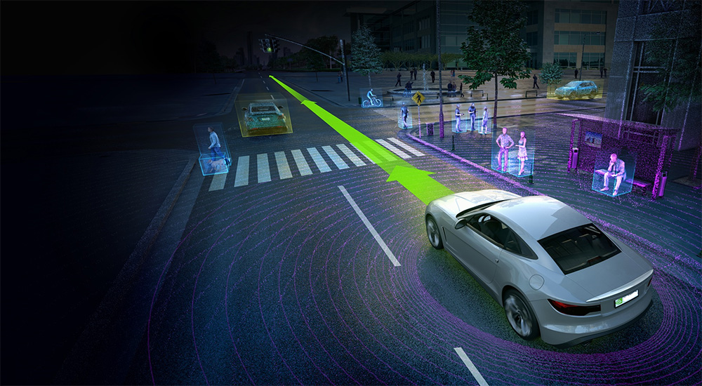
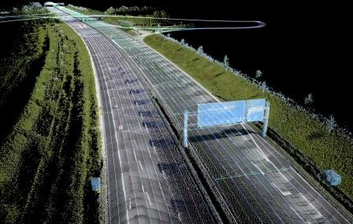
Questions?

